Slide 1
Marketing and Communications
June 2023-September 2023

Slide 2
Liberace Deep Media Coverage
New Annual Contracts for Outdoor ads, Online, Print and Radio
Social media workshops
Strategic Planning
RFP with for new Advertising Agency
Highlights
June -September 2023

Slide 3
Advertising Contracts
Reaching across the state with consistent and timely messaging
Lamar Outdoor for Southern NV
KNPR and Desert Companion
KUNR
Reno News & Review

Slide 4
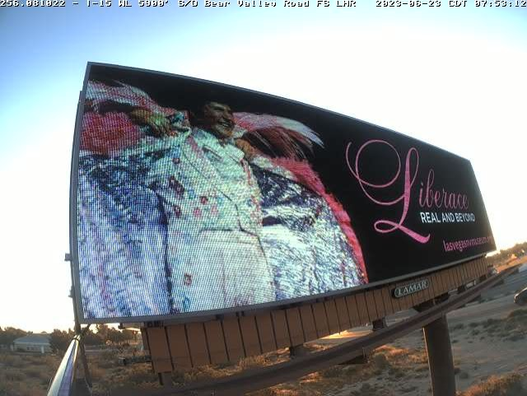
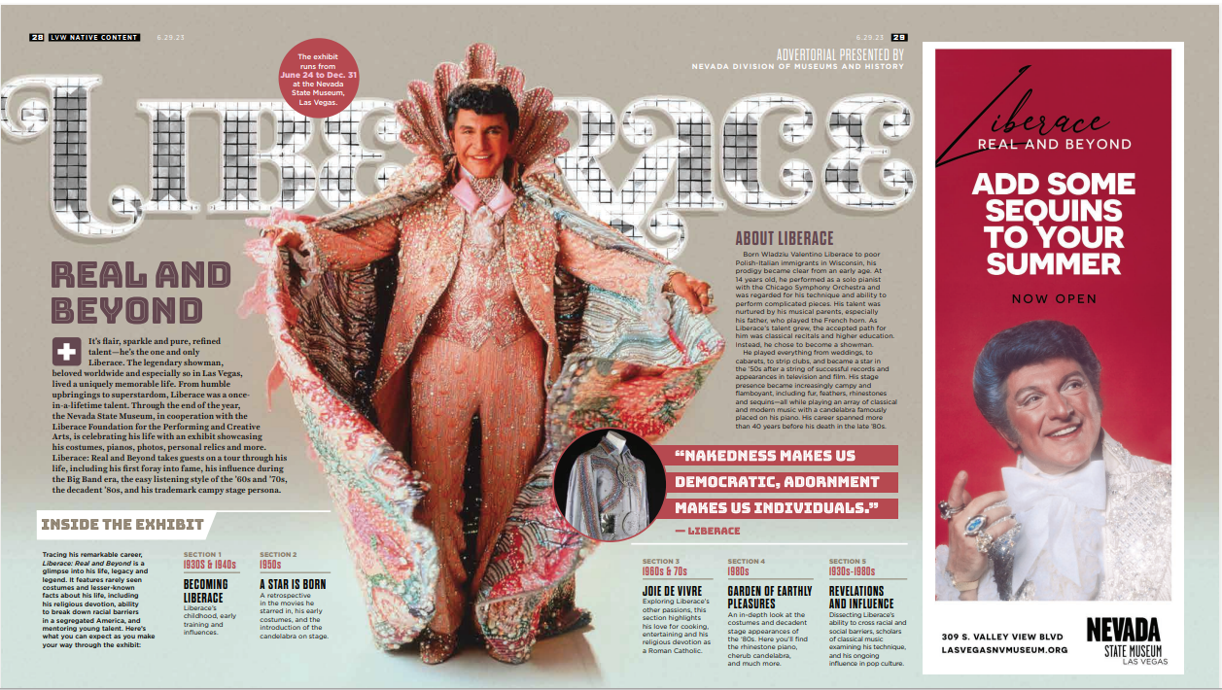
Advertising Samples

Slide 5
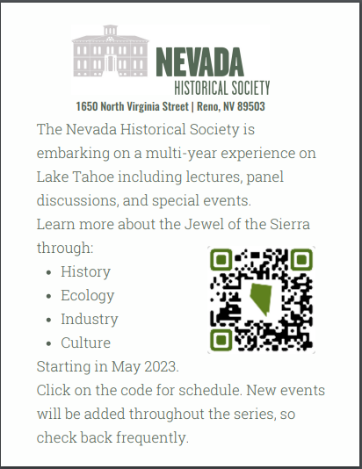
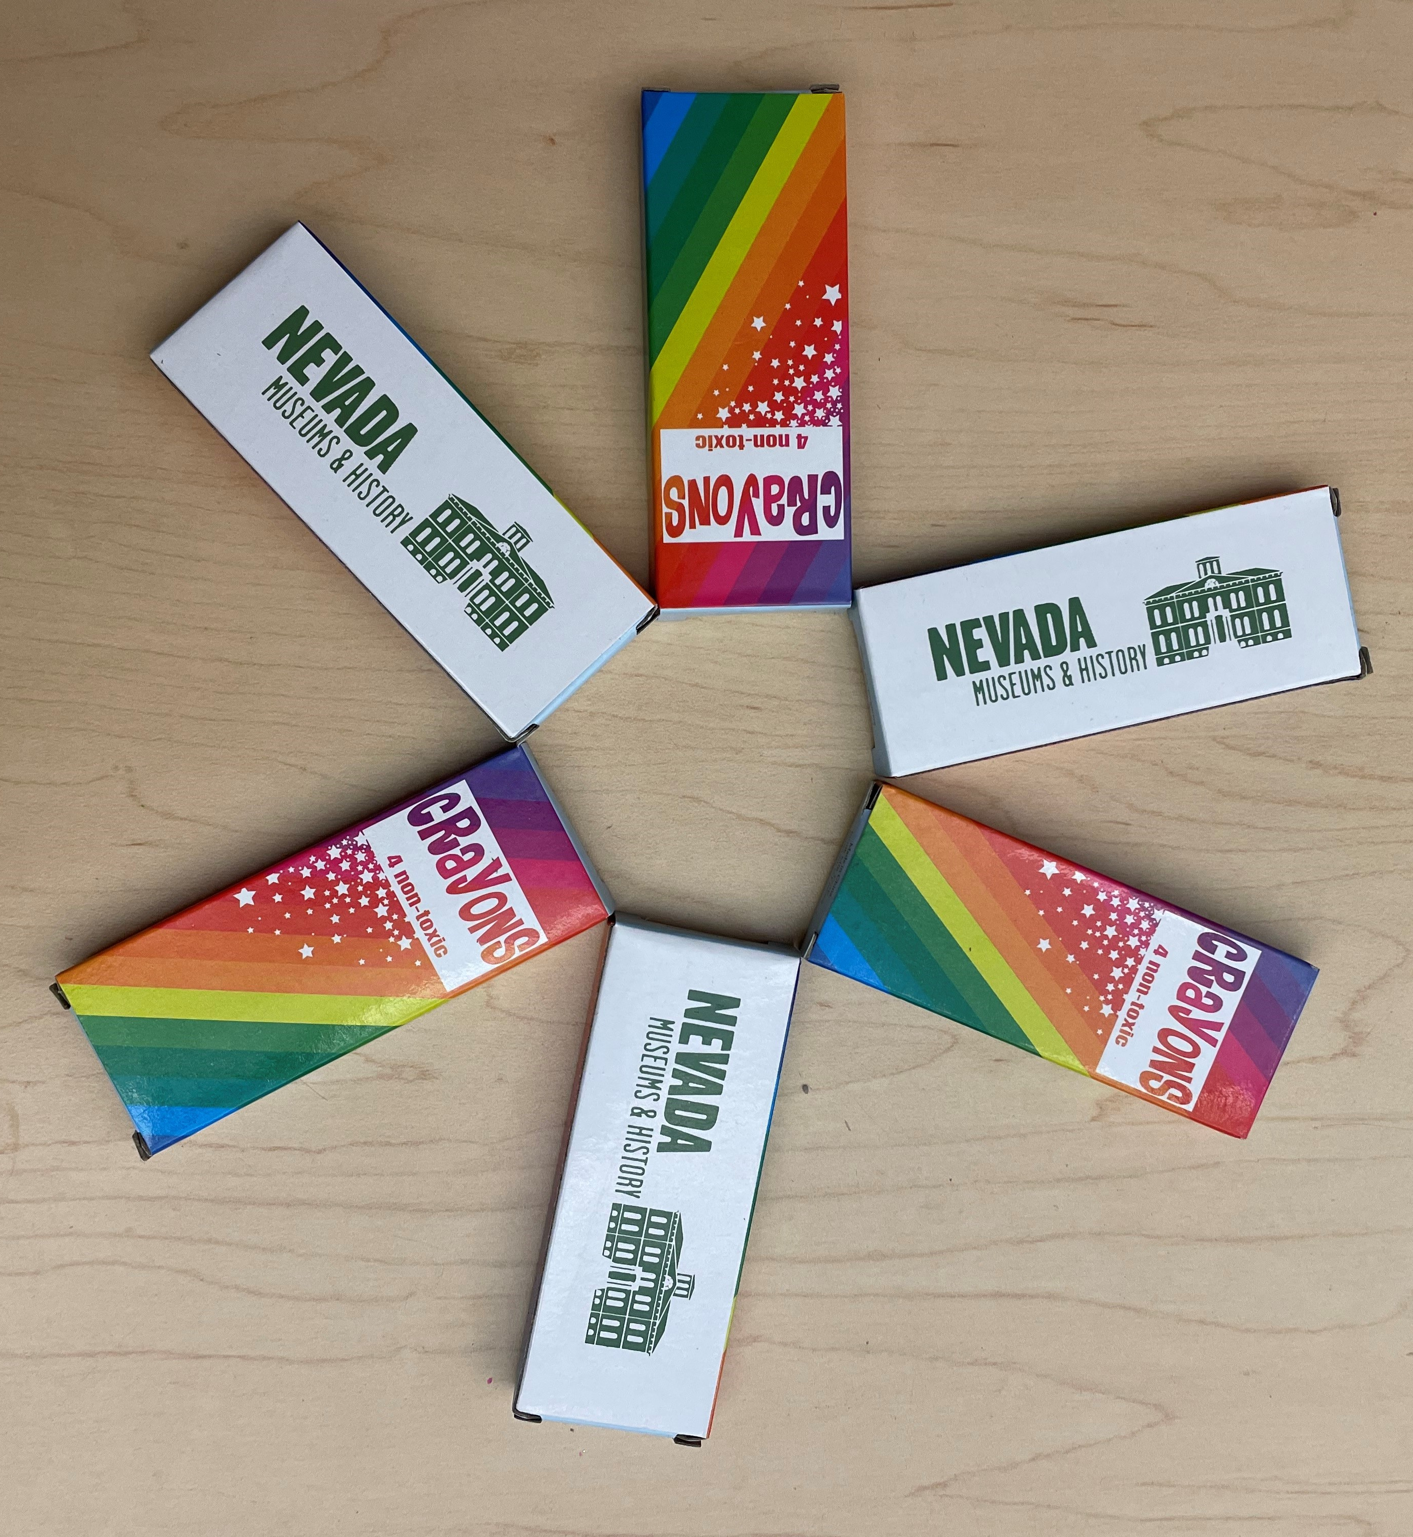
Samples

Slide 6
Media Coverage
Connecting with local journalists to tell the DMH Story:
Targeting educator newsletters for back-to-school programs within the museums and bus reimbursement program
Extensive media coverage for Liberace Exhibit
Two articles on the repatriation topic
“Best of” Award for NSMLV

Slide 7
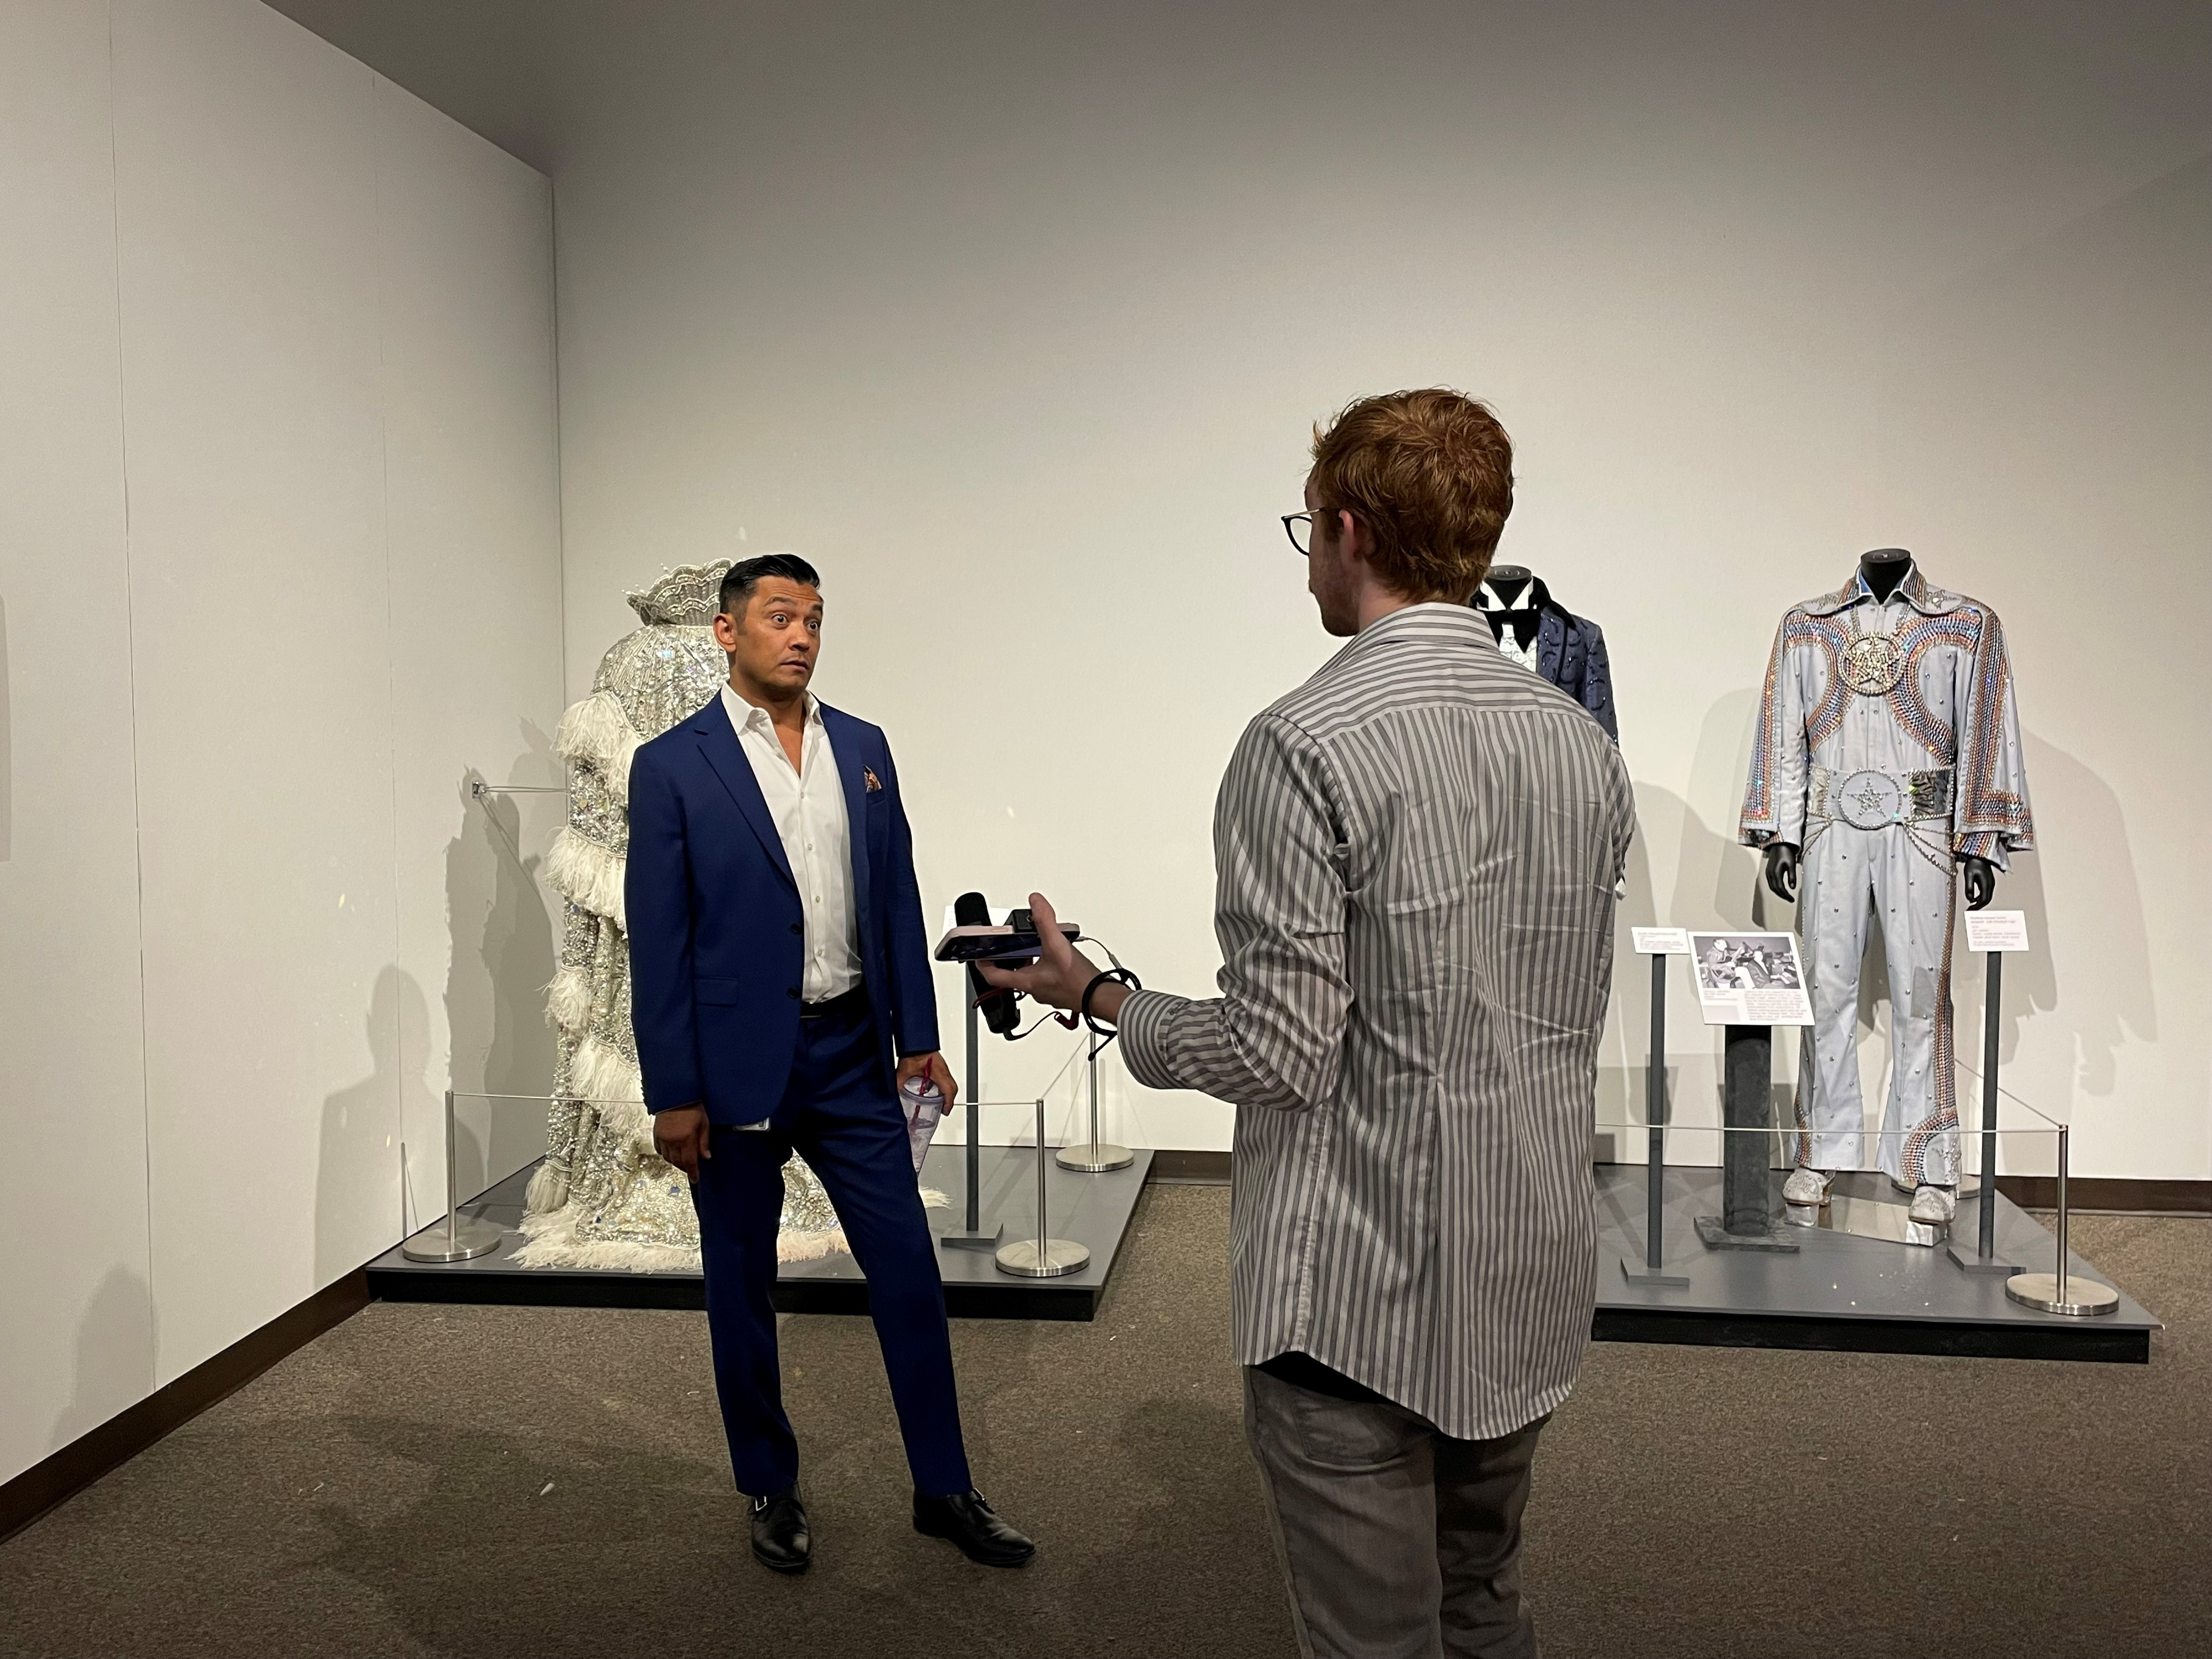
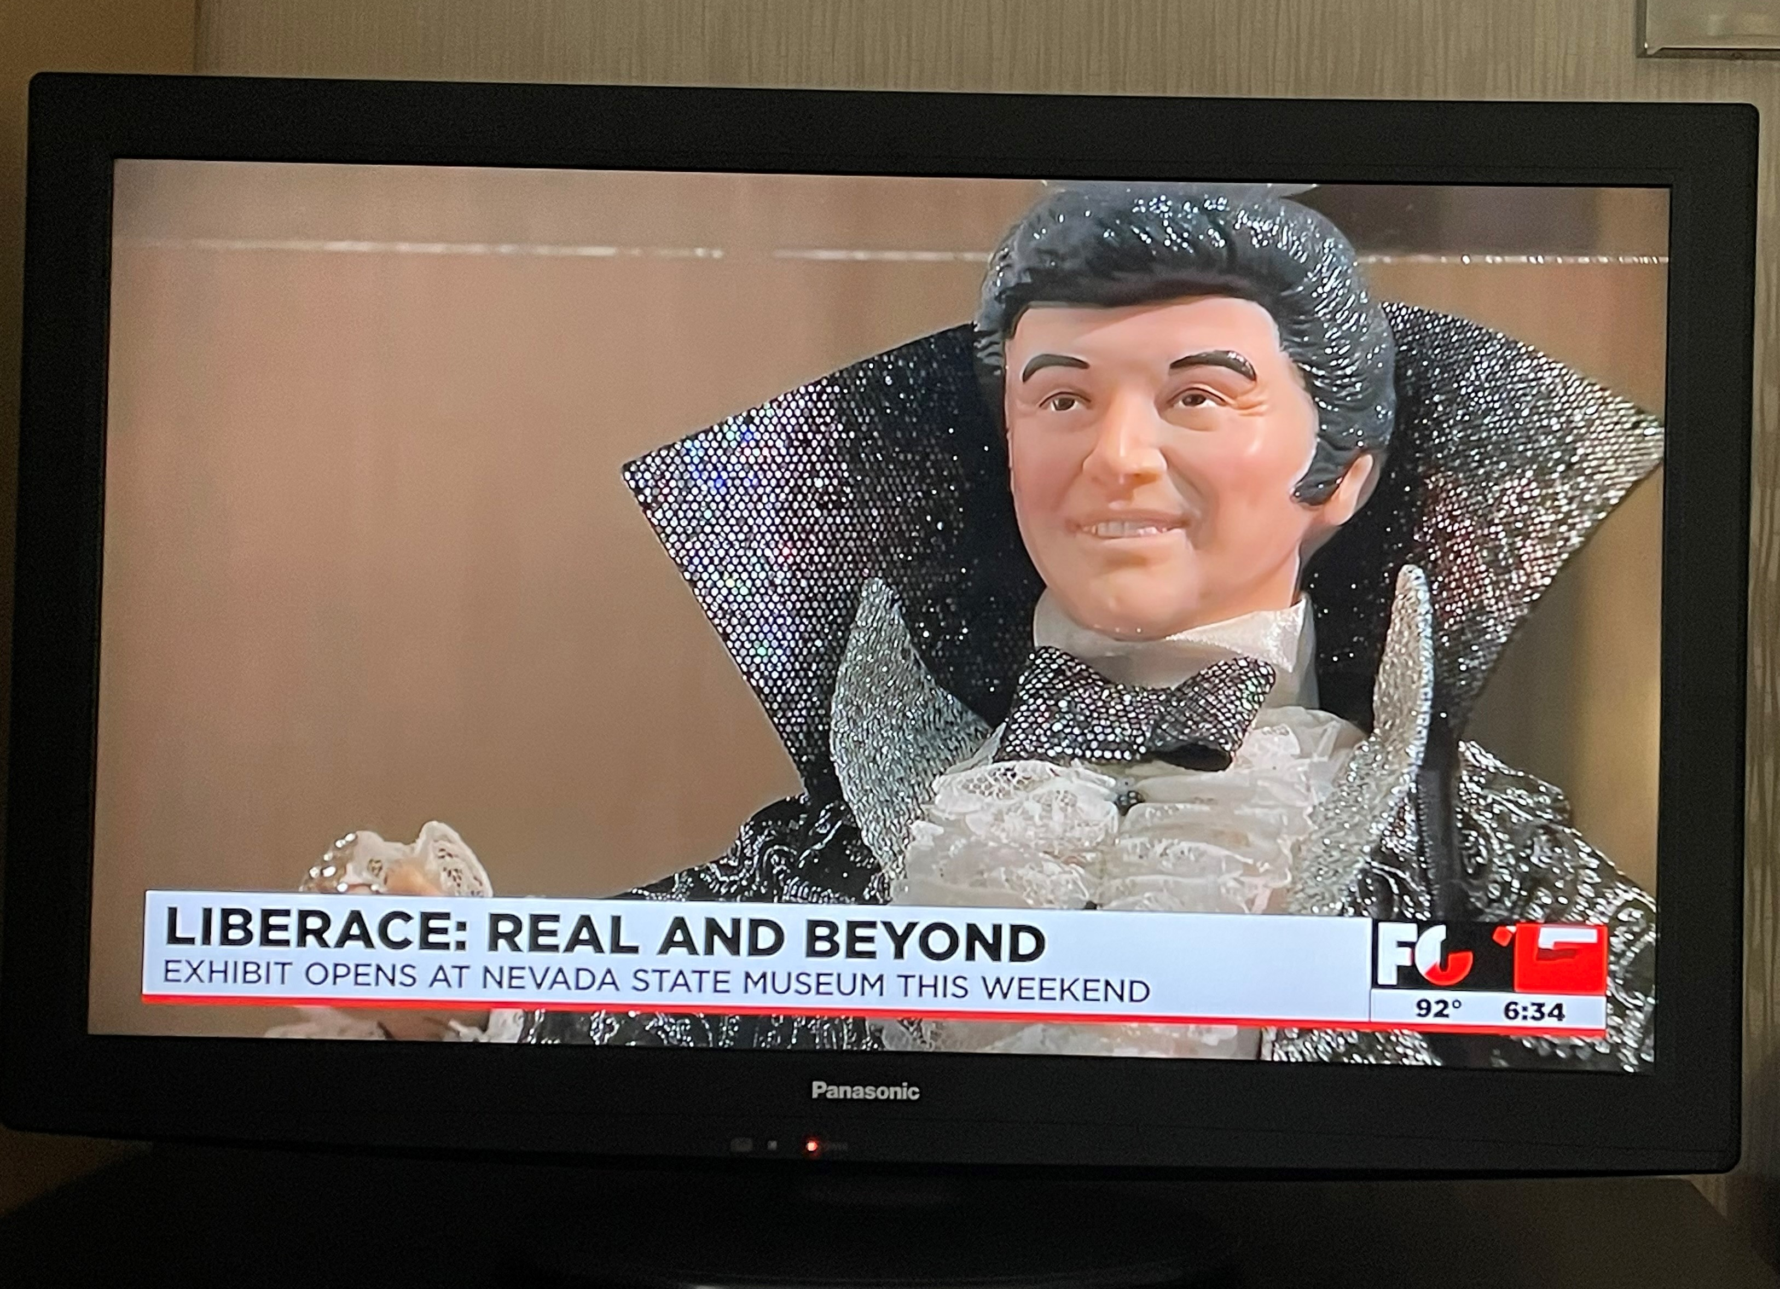
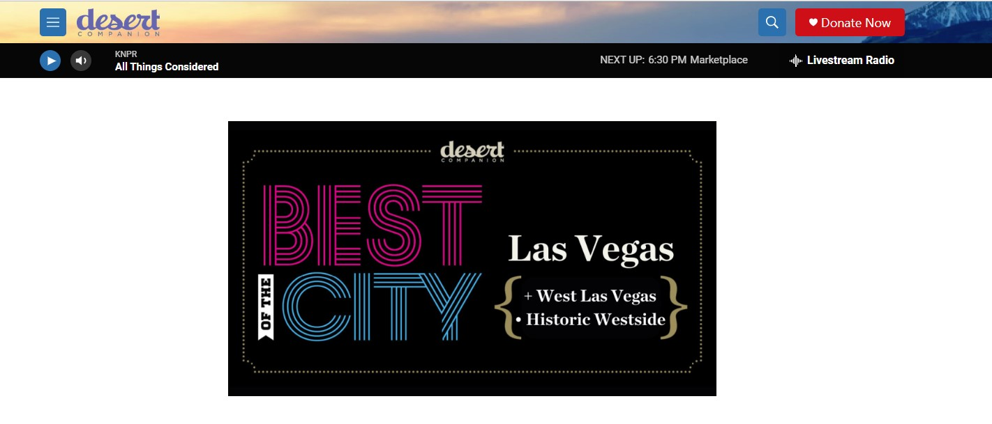
Media Coverage Samples

Slide 8
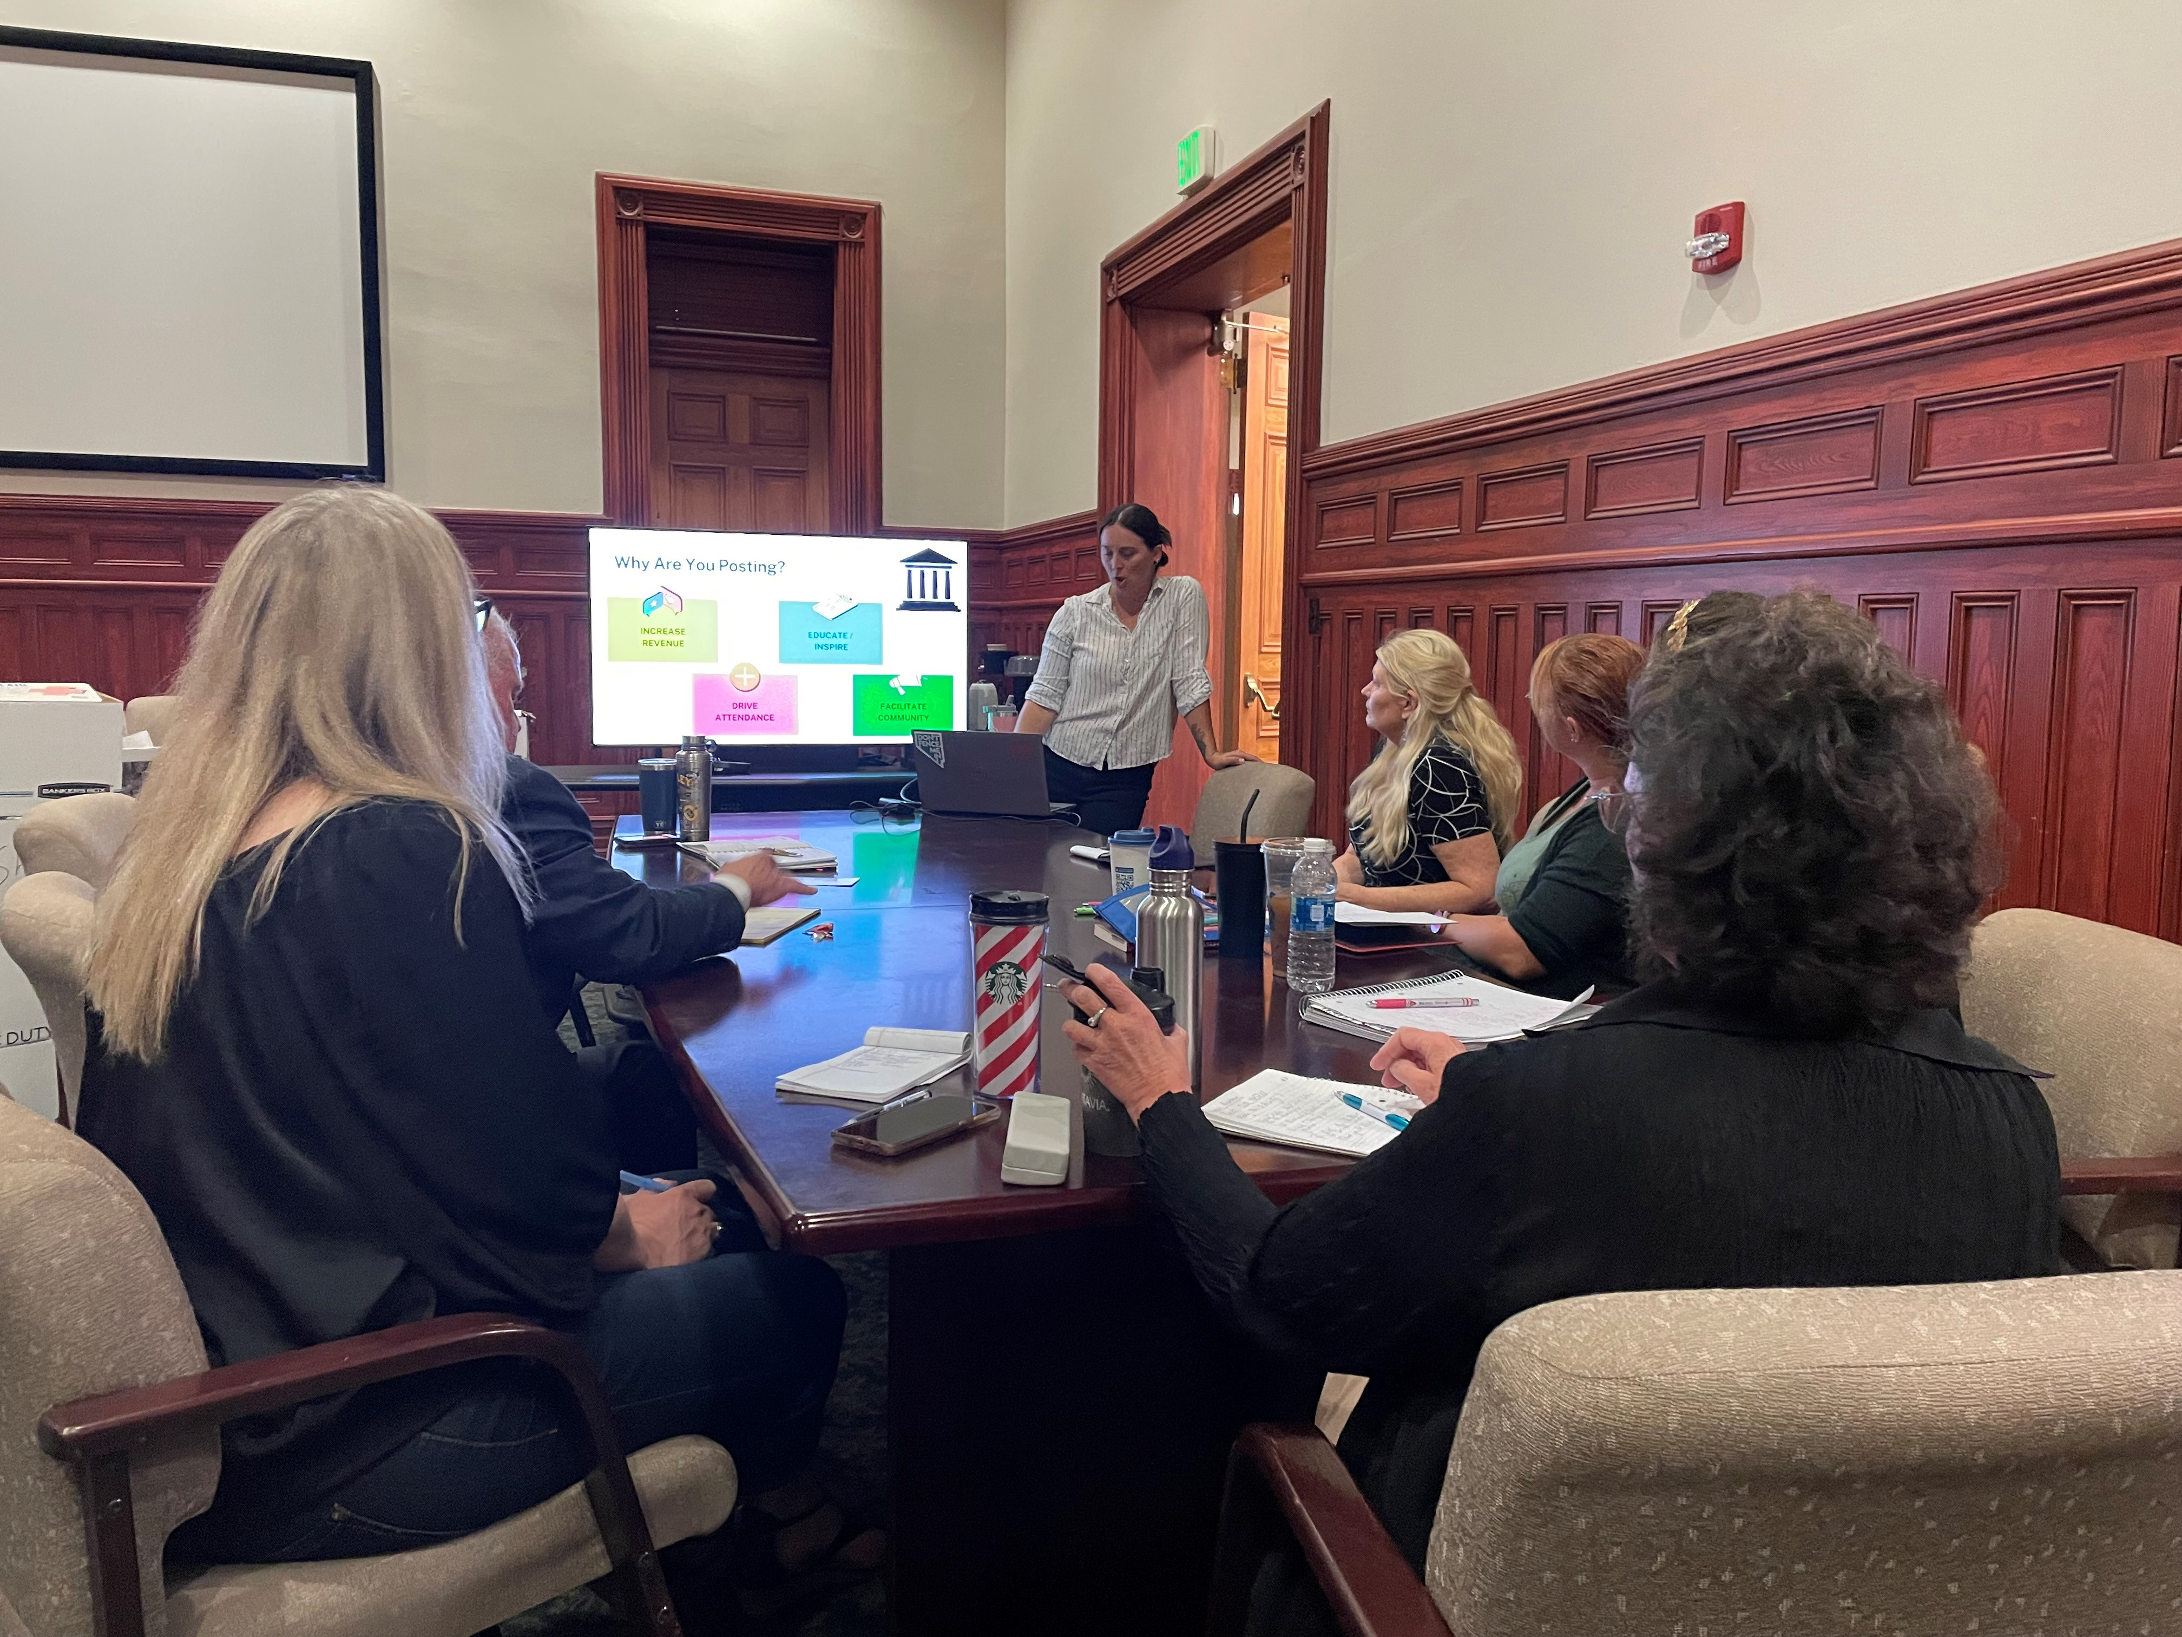
Social Media Workshops
Covered Topics
Why use Social Media
Demographics of users
How to use each media differently
Ideas for posting based on
Increase Revenue
Educate/Inspire
Drive Attendance
Facilitate Community
Overview on using Later platform for posting

Slide 9
Coming Up
Strategic Planning
Marketing & Communications Planning
Re-Branding Project
Working with Director Scolari on development
Usage of a mediator to help guide the conversation internally
Early surveys to set up our conversations
RFP to find new Advertising Agency or use of Master Services agreement with state approved vendor
Target date to be in place by October
COMING SOON
Branding
Website designs

Slide 10
Questions?

